Slide 1
Image Steganography
Image Steganography software application
By
ShubaaShree T
Computer Science Department, Avinashilingam university

Slide 2
Outline
Problem statement
Technology used
Wow factor
End users
Result
Conclusion
Git-hub link
Future scope

Slide 3
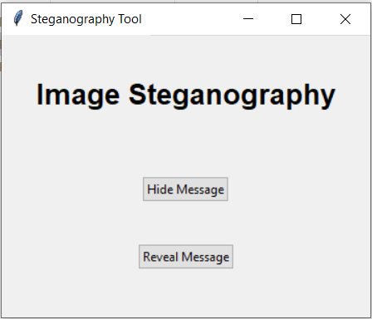
Problem statement
To create the Software based application for hiding the secret message in the image and extracting the secret message in the image through encoding and decoding the messages through password by steganography

Slide 4





Technology used
Pycharm
PyCharm is an integrated development environment (IDE) used for programming in Python.
Python
Python is a high-level, general-purpose programming language. Its design philosophy emphasizes code readability with the use of significant indentation.
Software
OS : windows 10
hardware
Processor : AMD Althon
RAM : 16GB

Slide 5
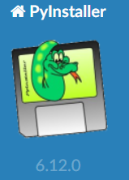
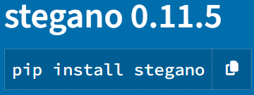
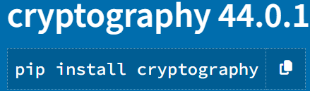

Wow factor
Stegano
Cryptography-fernet
tkinter
pyinstaller
It have inbuild LSB method
It have inbuild encrypt and decrypt method
GUI
Turn python file into executable file

Slide 6
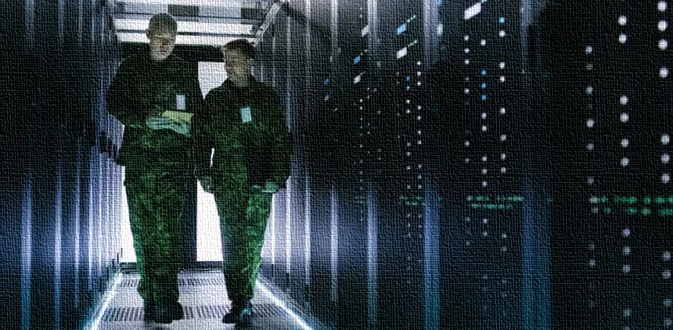
End Users
Military and cyber security people

Slide 7
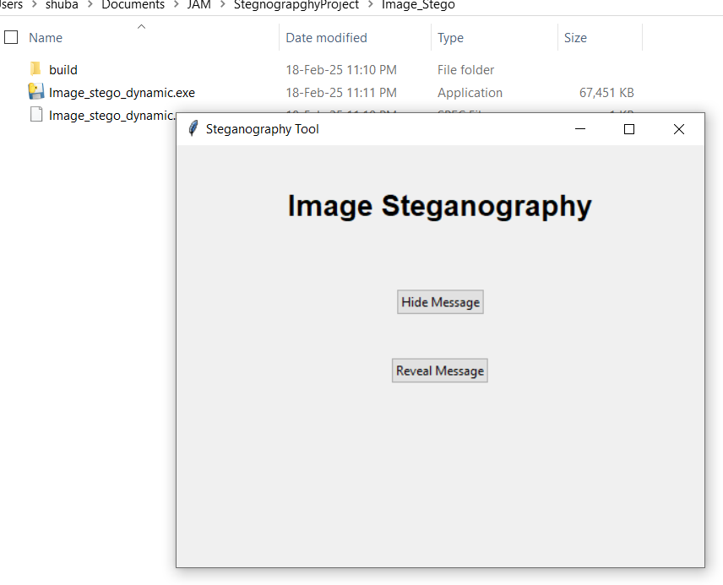
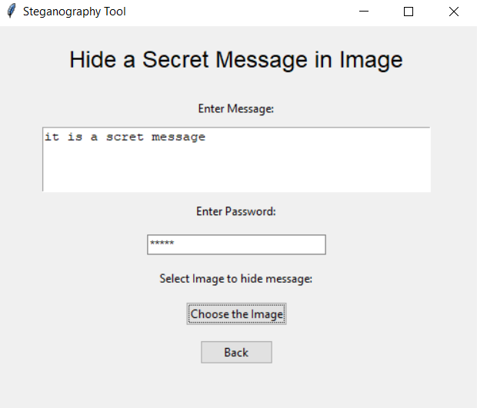
Result
home window
Hide Message

Slide 8
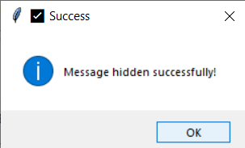
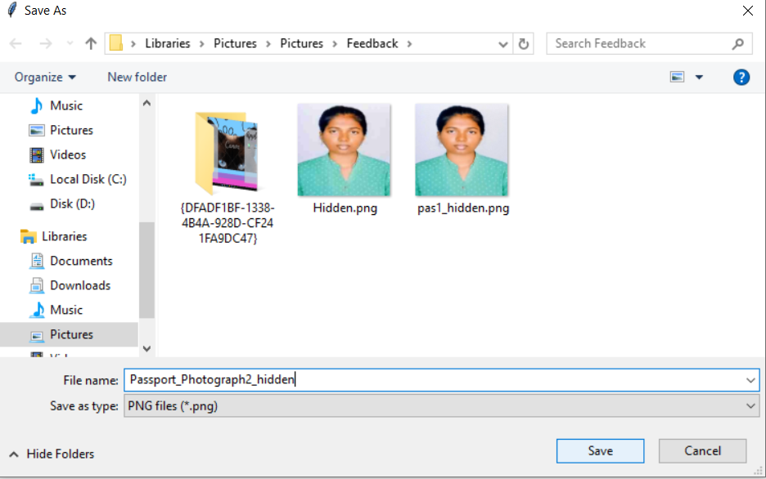
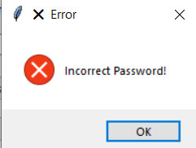
Result
Select image
Message prompt

Slide 9
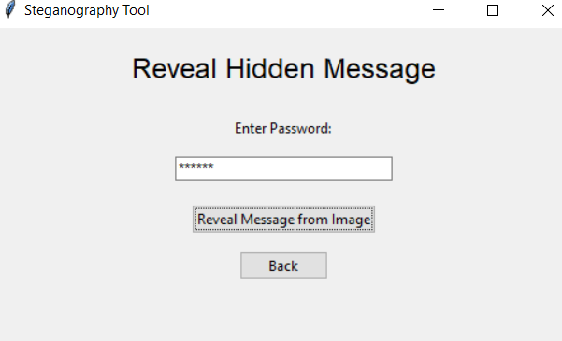
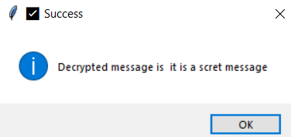
Result
Reveal message
Result

Slide 10
Conclusion
This project successfully implements image-based steganography, allowing users to securely hide and reveal messages within images using a software Application . It supports encryption with passwords, multiple image formats, and error handling for a user-friendly experience.

Slide 11
Git-hub
https://github.com/Hubaas/ImageStegnography

Slide 12
Future Scope
Future improvements can include stronger encryption, enhanced UI, and broader file format support for increased security and usability.

